Slide 1
Media & Entertainment Analytics
Capstone Project
Navneet Kumar
24MBMA47

Slide 2
Understanding the OTT Landscape
Over-the-top (OTT) platforms generate massive volumes of user interaction data. Analytics has become essential for understanding viewer behavior, optimizing content delivery, and maximizing subscriber lifetime value.
User Behavior
Predictive Models
Identify viewing patterns and content preferences
Build algorithms to forecast churn and demand
Optimization
Enhance content delivery and platform performance

Slide 3
Five Strategic Use Cases
This capstone explores five interconnected analytics challenges that drive OTT platform success.
1
2
3
Viewing Patterns
Recommendations
Churn Prediction
Detect content trends and audience preferences across segments
Build systems that suggest personalized content
Identify at-risk subscribers before they unsubscribe
4
5
Regional Demand
Traffic Optimization
Forecast content popularity by geographic market
Analyze peak load times and optimize infrastructure

Slide 4

Dataset Architecture & Features
A comprehensive synthetic dataset was engineered with 25+ attributes spanning user profiles, content metadata, viewing behavior, and system performance metrics.
User Dimensions
Behavioral Metrics
Demographics (age, gender, region)
Watch time (daily, total, completion)
Subscription data (type, dates, status)
Content ratings & recommendations
Device & network information
Stream quality & buffering events
Account activity (login, sessions)
Financial data (payment, spend)

Slide 5




Analytical Approach & Methodology
Leveraging enterprise-scale tools and machine learning techniques to extract actionable insights from OTT platform data.
Data Preparation
Cleaned and preprocessed data; handled missing values and outliers
Feature Engineering
Derived 30+ features capturing viewing dynamics and user lifecycle patterns
Model Selection
Tools: PySpark for distributed processing, Databricks for collaborative analytics, scikit-learn and MLlib for machine learning implementations.
Applied Logistic Regression, Random Forest, and Gradient Boosting Trees for classification; time series methods for forecasting

Slide 6
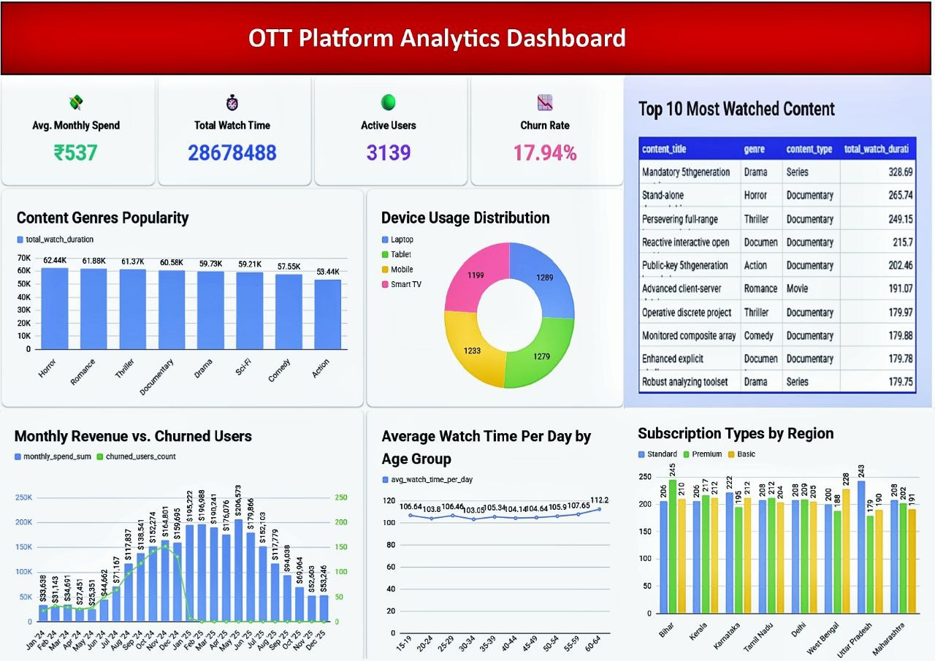
Key Findings & Results
Analysis revealed critical patterns in user engagement, subscription retention, and content demand that directly inform platform strategy.
Viewing Insights
Peak engagement occurs 7-10 PM; drama and international content dominate; genre preferences vary significantly by region
Churn Prediction
Model achieved 85%+ accuracy; low engagement in first 30 days is strongest churn indicator
Recommendations
Precision and recall both >80%; collaborative filtering captures user preferences effectively

Slide 7
Challenges Overcome
Real-world analytics projects encounter significant technical and analytical hurdles. Strategic solutions ensured project success at scale.
Technical Challenges
Solutions Implemented
Memory optimization for multi-GB datasets in PySpark
Partitioning strategies and lazy evaluation
Handling sparse data and missing values
Domain-driven imputation and filtering
Managing feature explosion across use cases
Feature selection and dimensionality reduction

Slide 8
Conclusion & Future Horizons
This capstone demonstrates that sophisticated analytics can drive measurable business value in OTT platforms through data-informed decision-making and continuous optimization.
Core Achievements
User engagement patterns identified; churn accurately predicted; content strategy recommendations validated
Next Steps
Real-time dashboards, sentiment analysis from reviews, and advanced personalization engines will unlock deeper insights

